Slide 1
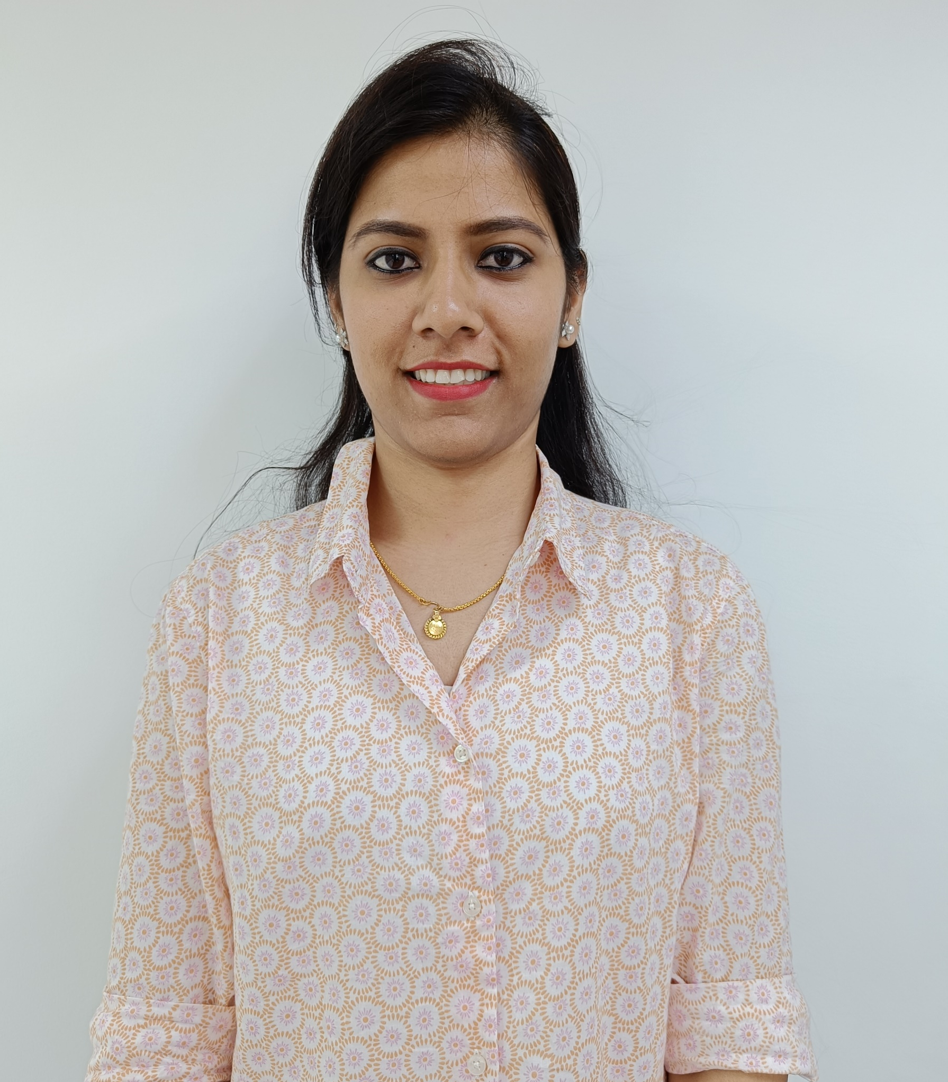
Three+ years of experience in areas of Market Mix Modelling Projects
Professional experience includes marketing analytics work for Mondelez, URC and TCCC for the ASEAN region
Supported the SEA region FTE engagement on MMM for one of the major CPG clients. Job role included:
Data collection, data harmonization, and MMM for multiple brands, countries, and channel combinations in SEA
Developing category forecast model for multiple categories to facilitate monthly category planning
Enabled “Always On” at the quarterly frequency using MMM insights for volume diagnosis.
Adaptable to learning new business problems that involve analytical and logical reasoning within the marketing analytics area.
Experience working in Demand Drivers, Excel, PPT and Python.
Dhanusha K
Consultant
Prior Experience
Hewlett Packard Inc.
Data Engineer
Higher Graduation
Data science course from Jigsaw Academy
B. E in ECE from East Point College of Engineering for Women, Bangalore.

